Slide 1
Bluetooth OBD-II Diagnostic Tool
Zak Rowland

Slide 2
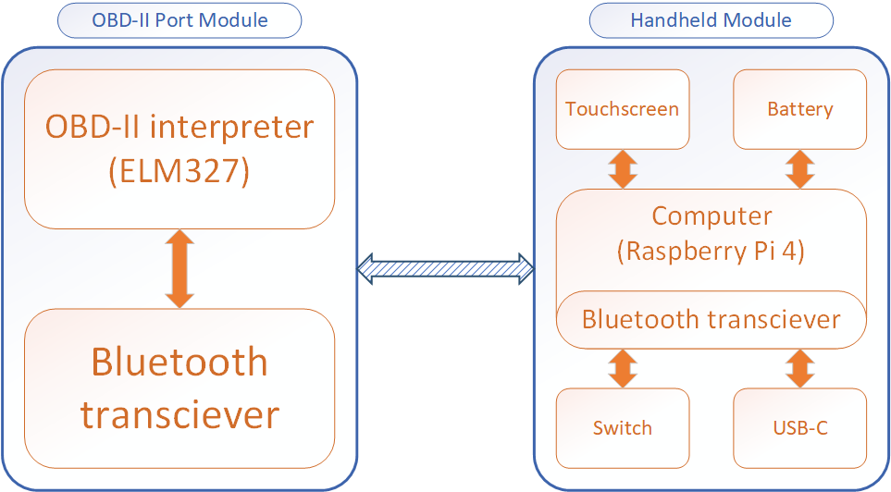
System block diagram

Slide 3
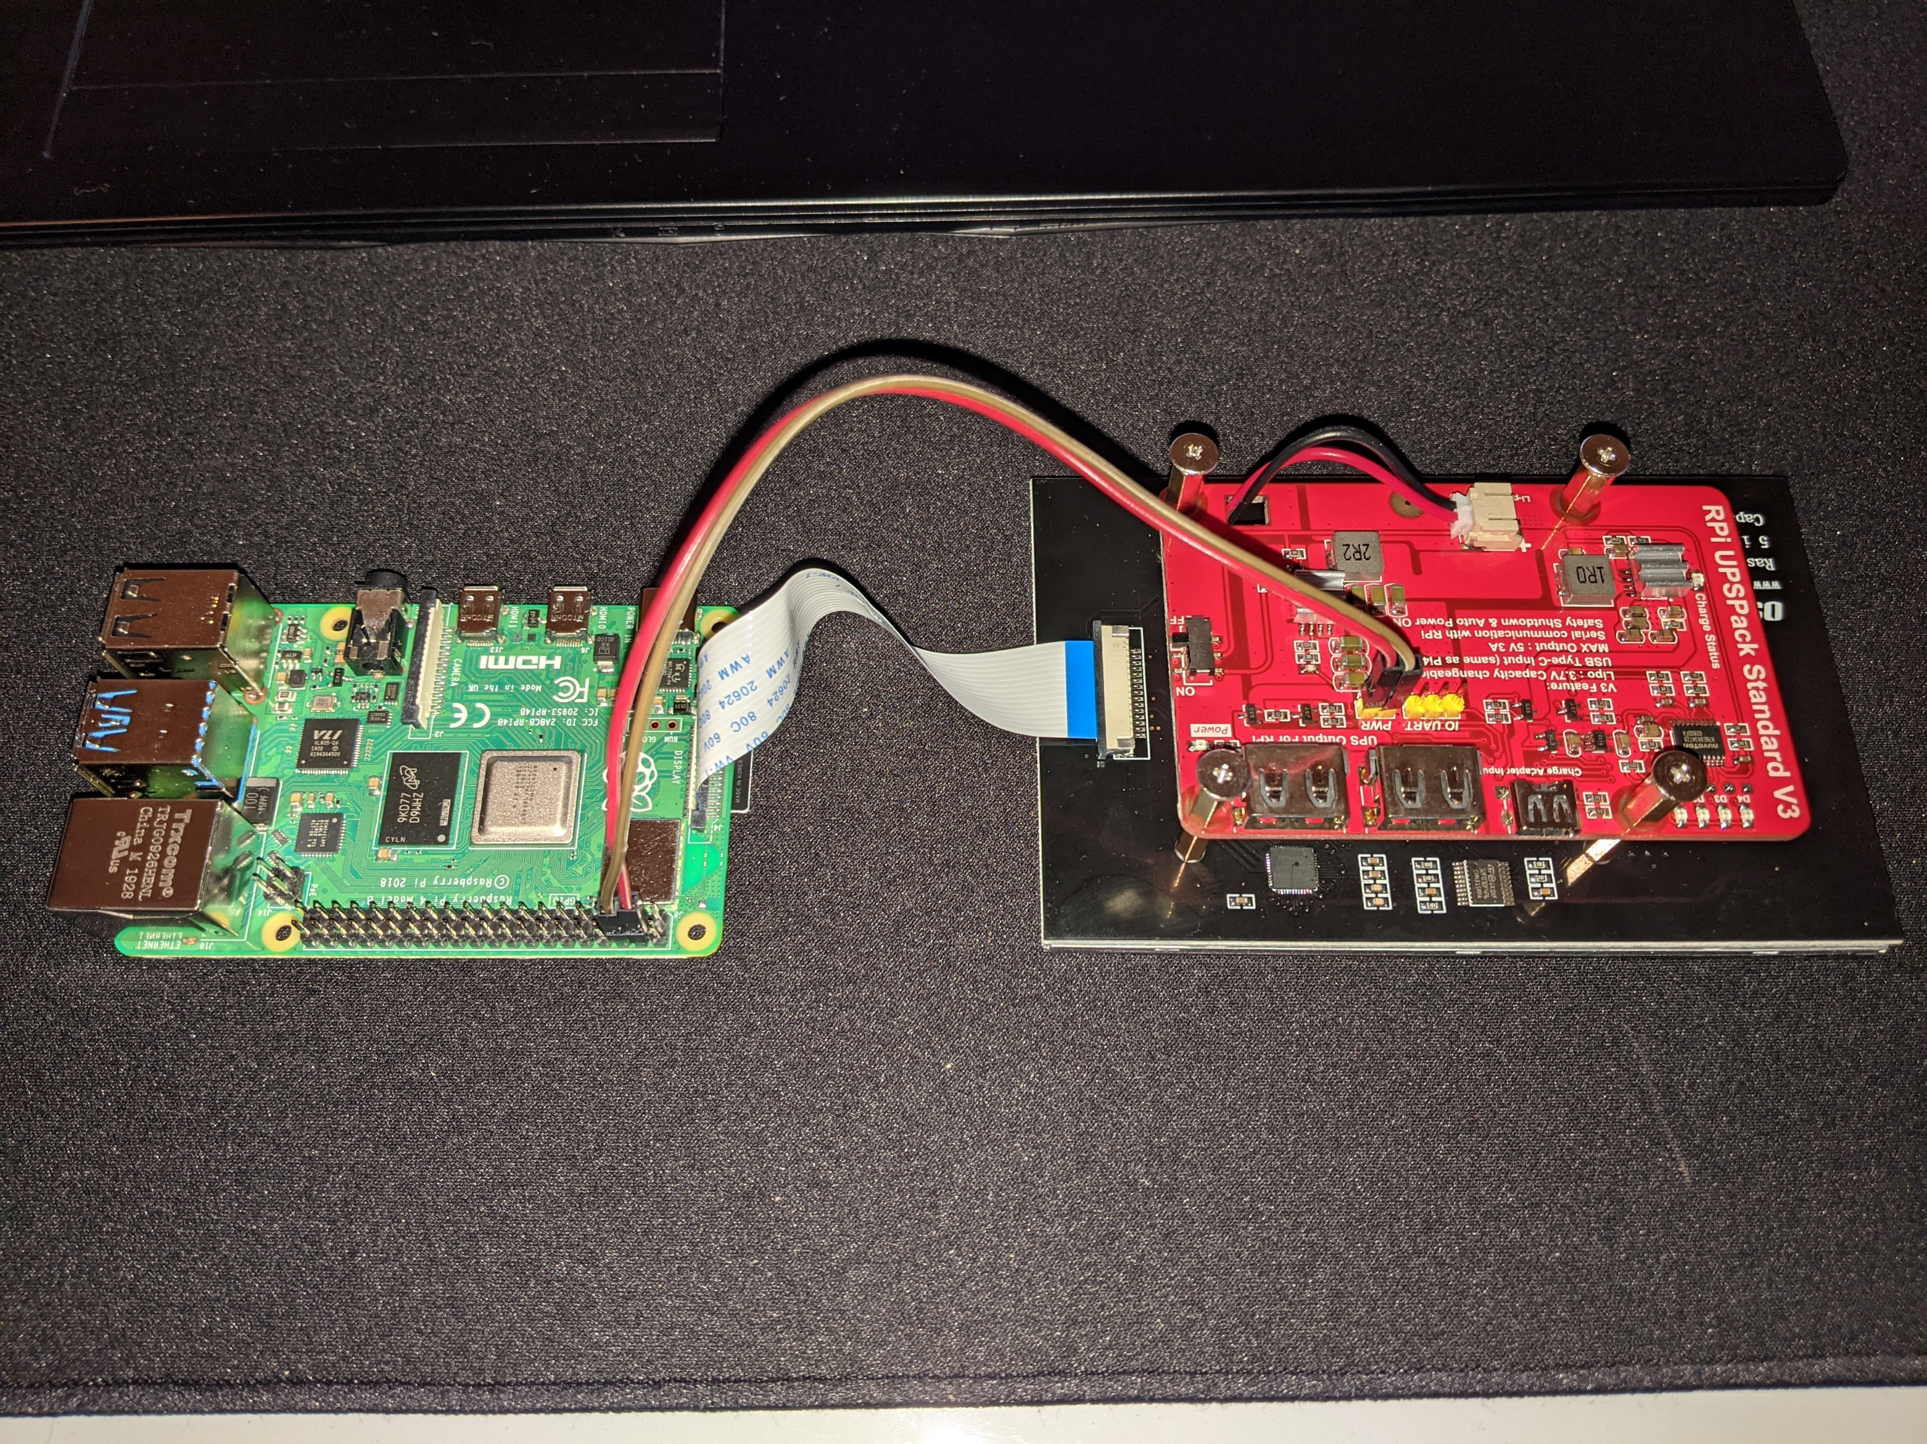
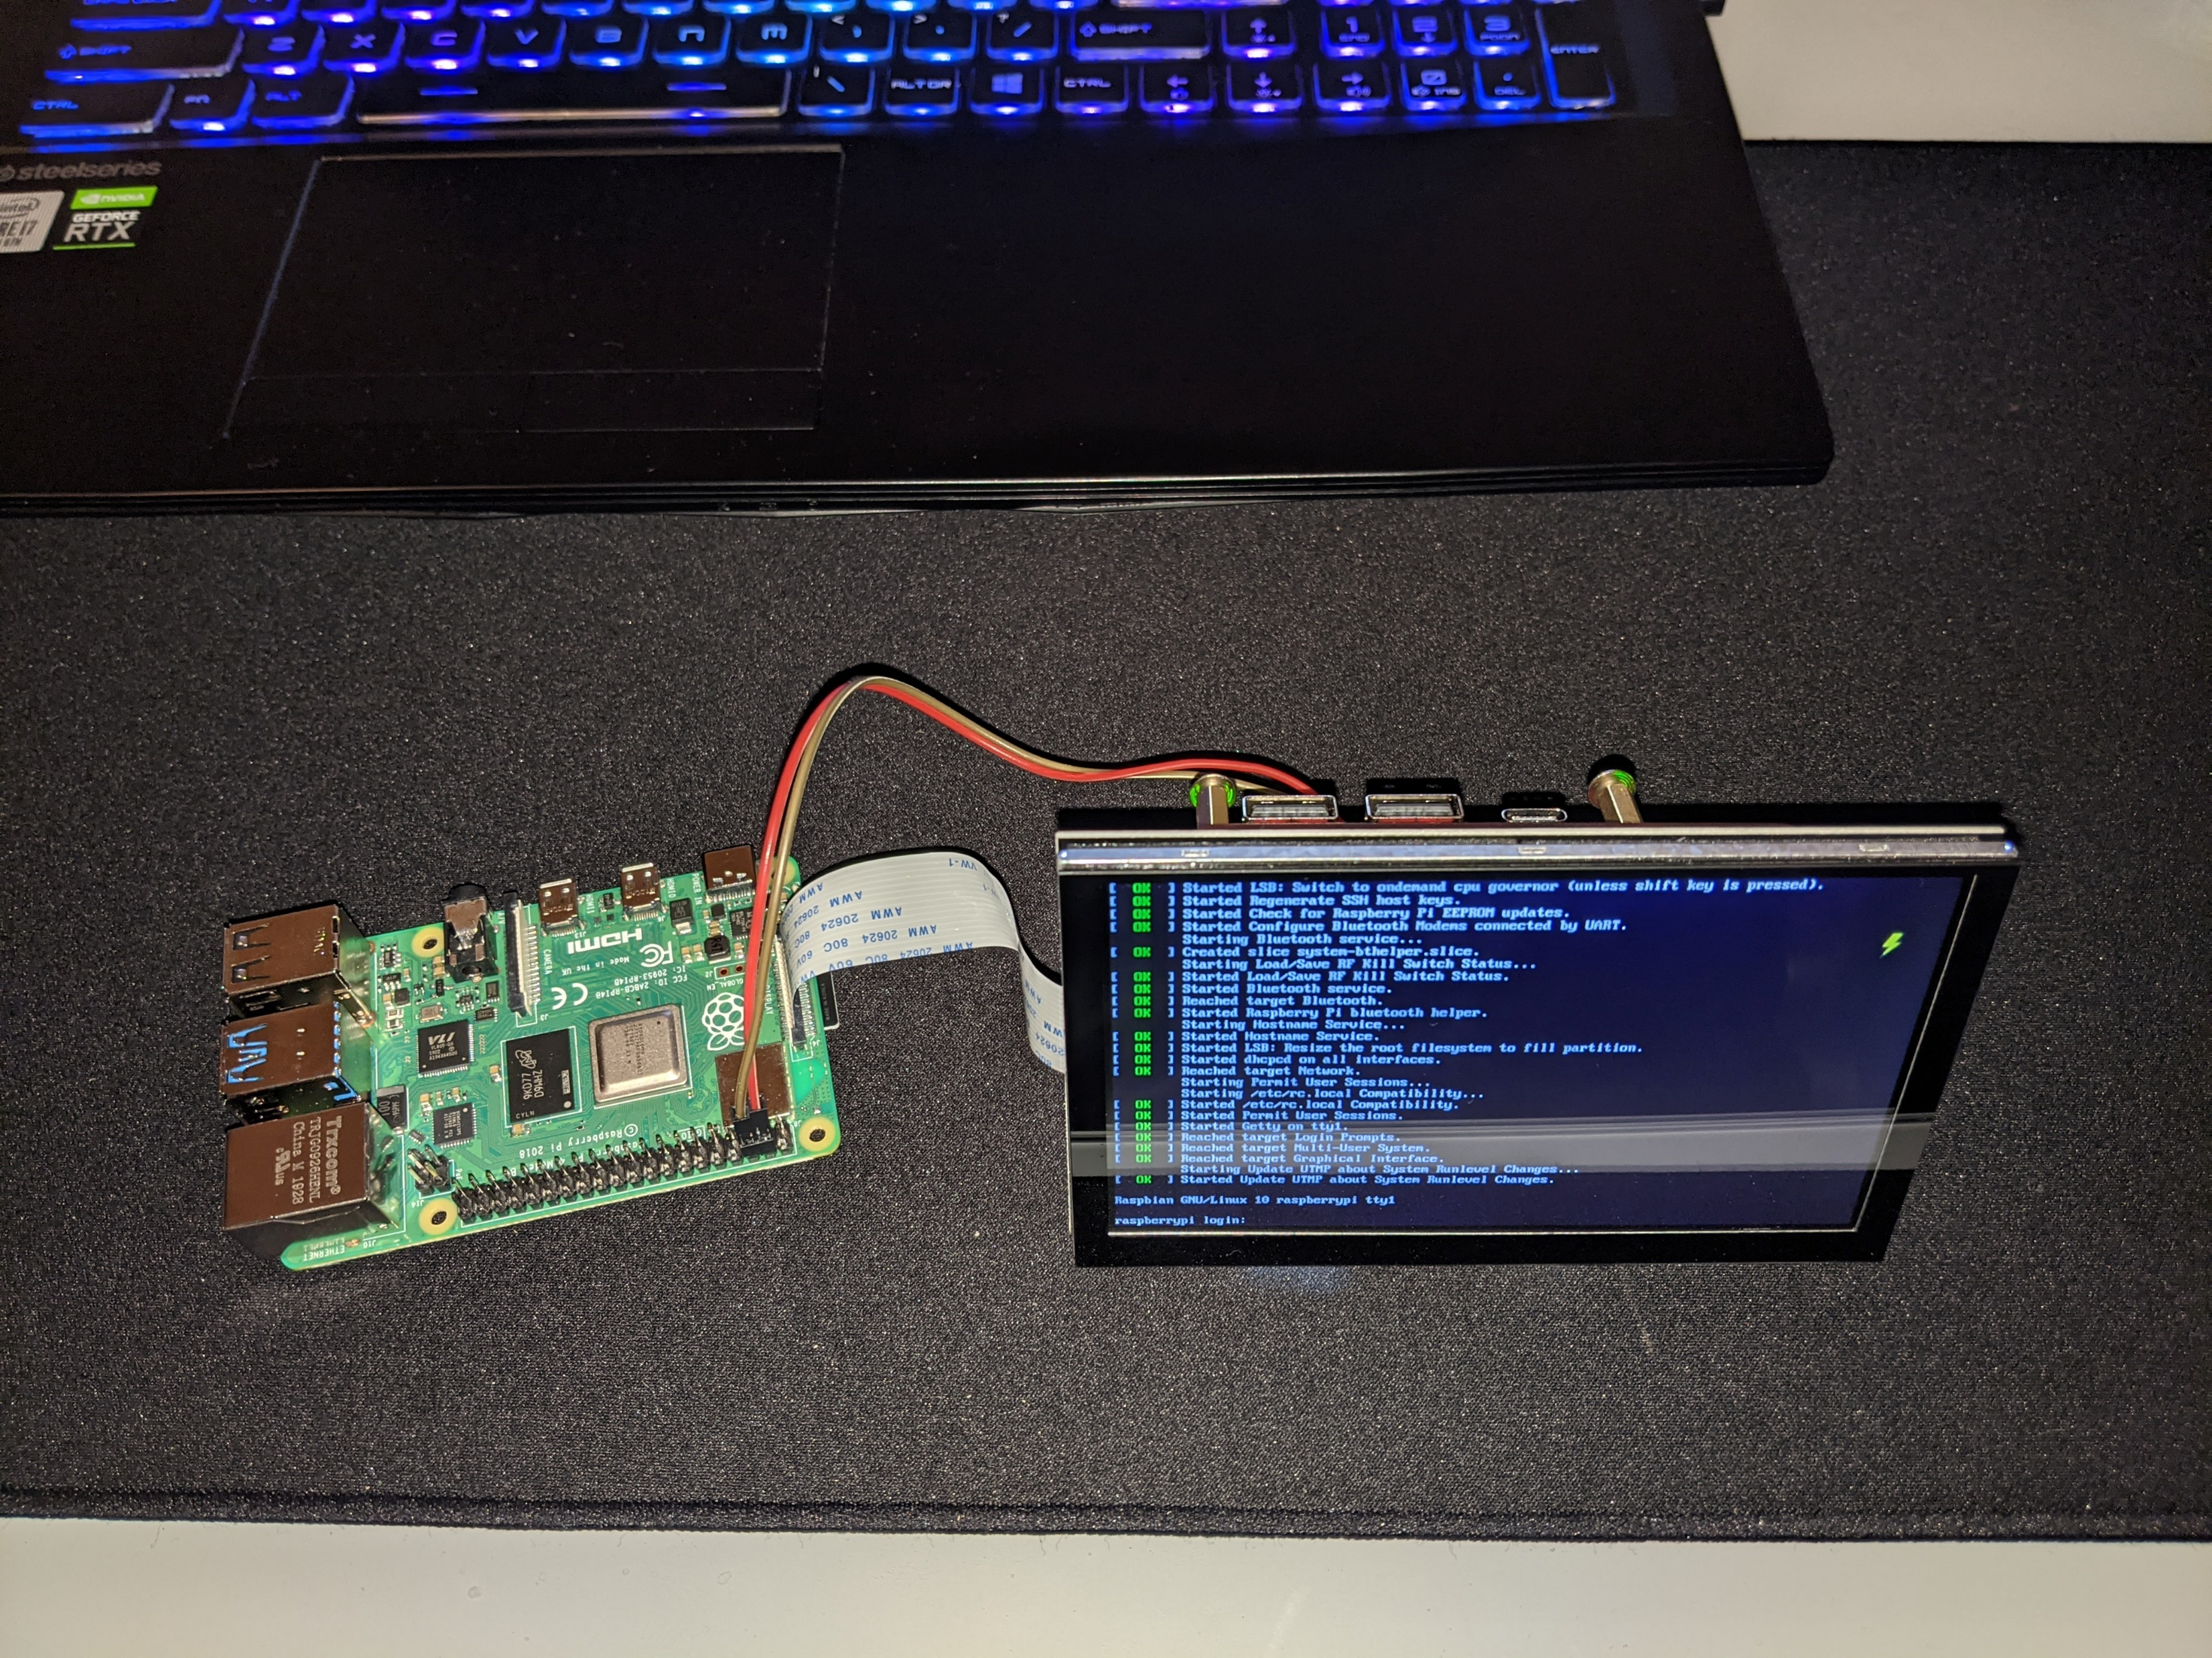
System functionality
The ESP32 microcontroller interfaces with an ELM327 OBD-II interpreter
The ESP32 writes commands and reads data through a wired serial connection
A Bluetooth connection between the Raspberry Pi 4 and the ESP32 will allow the user of the Raspberry Pi to interface with a vehicle wirelessly
The Raspberry Pi will utilize Python scripts to communicate data and build a GUI
The Raspberry Pi will be powered by a rechargeable battery and have its own touchscreen

Slide 4
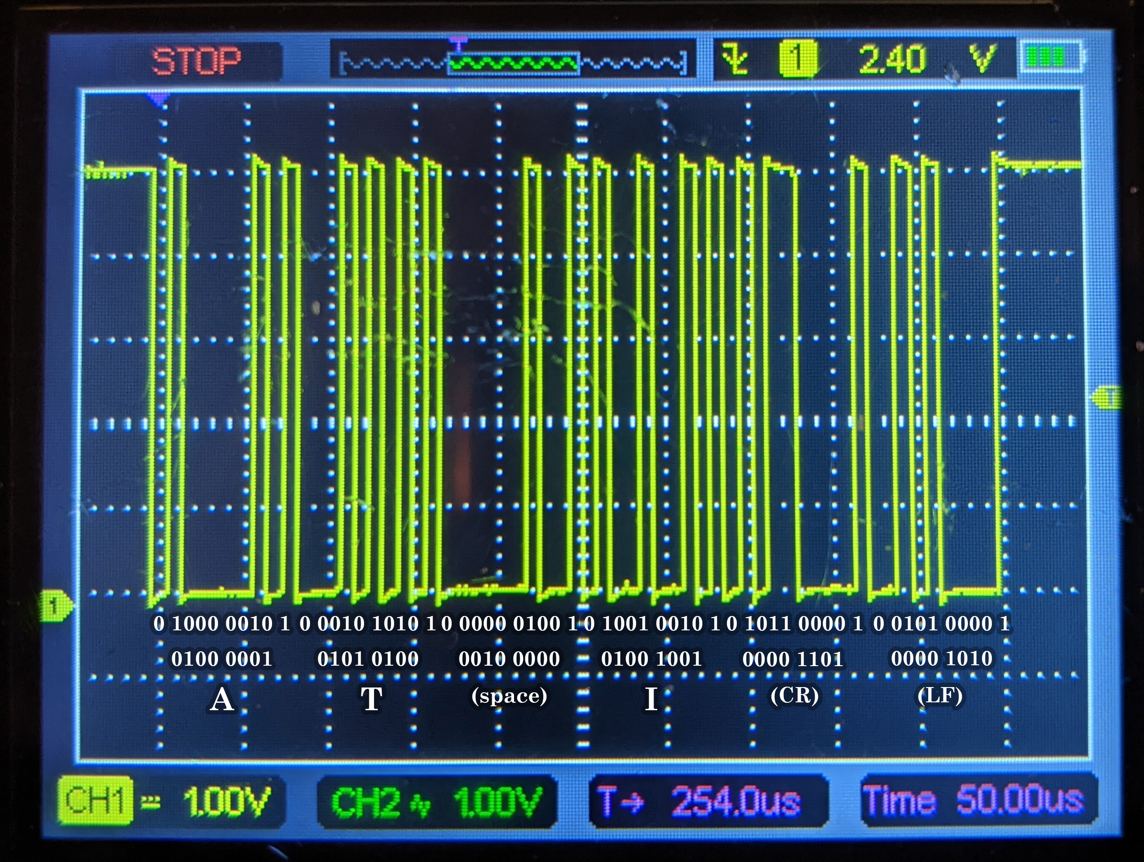
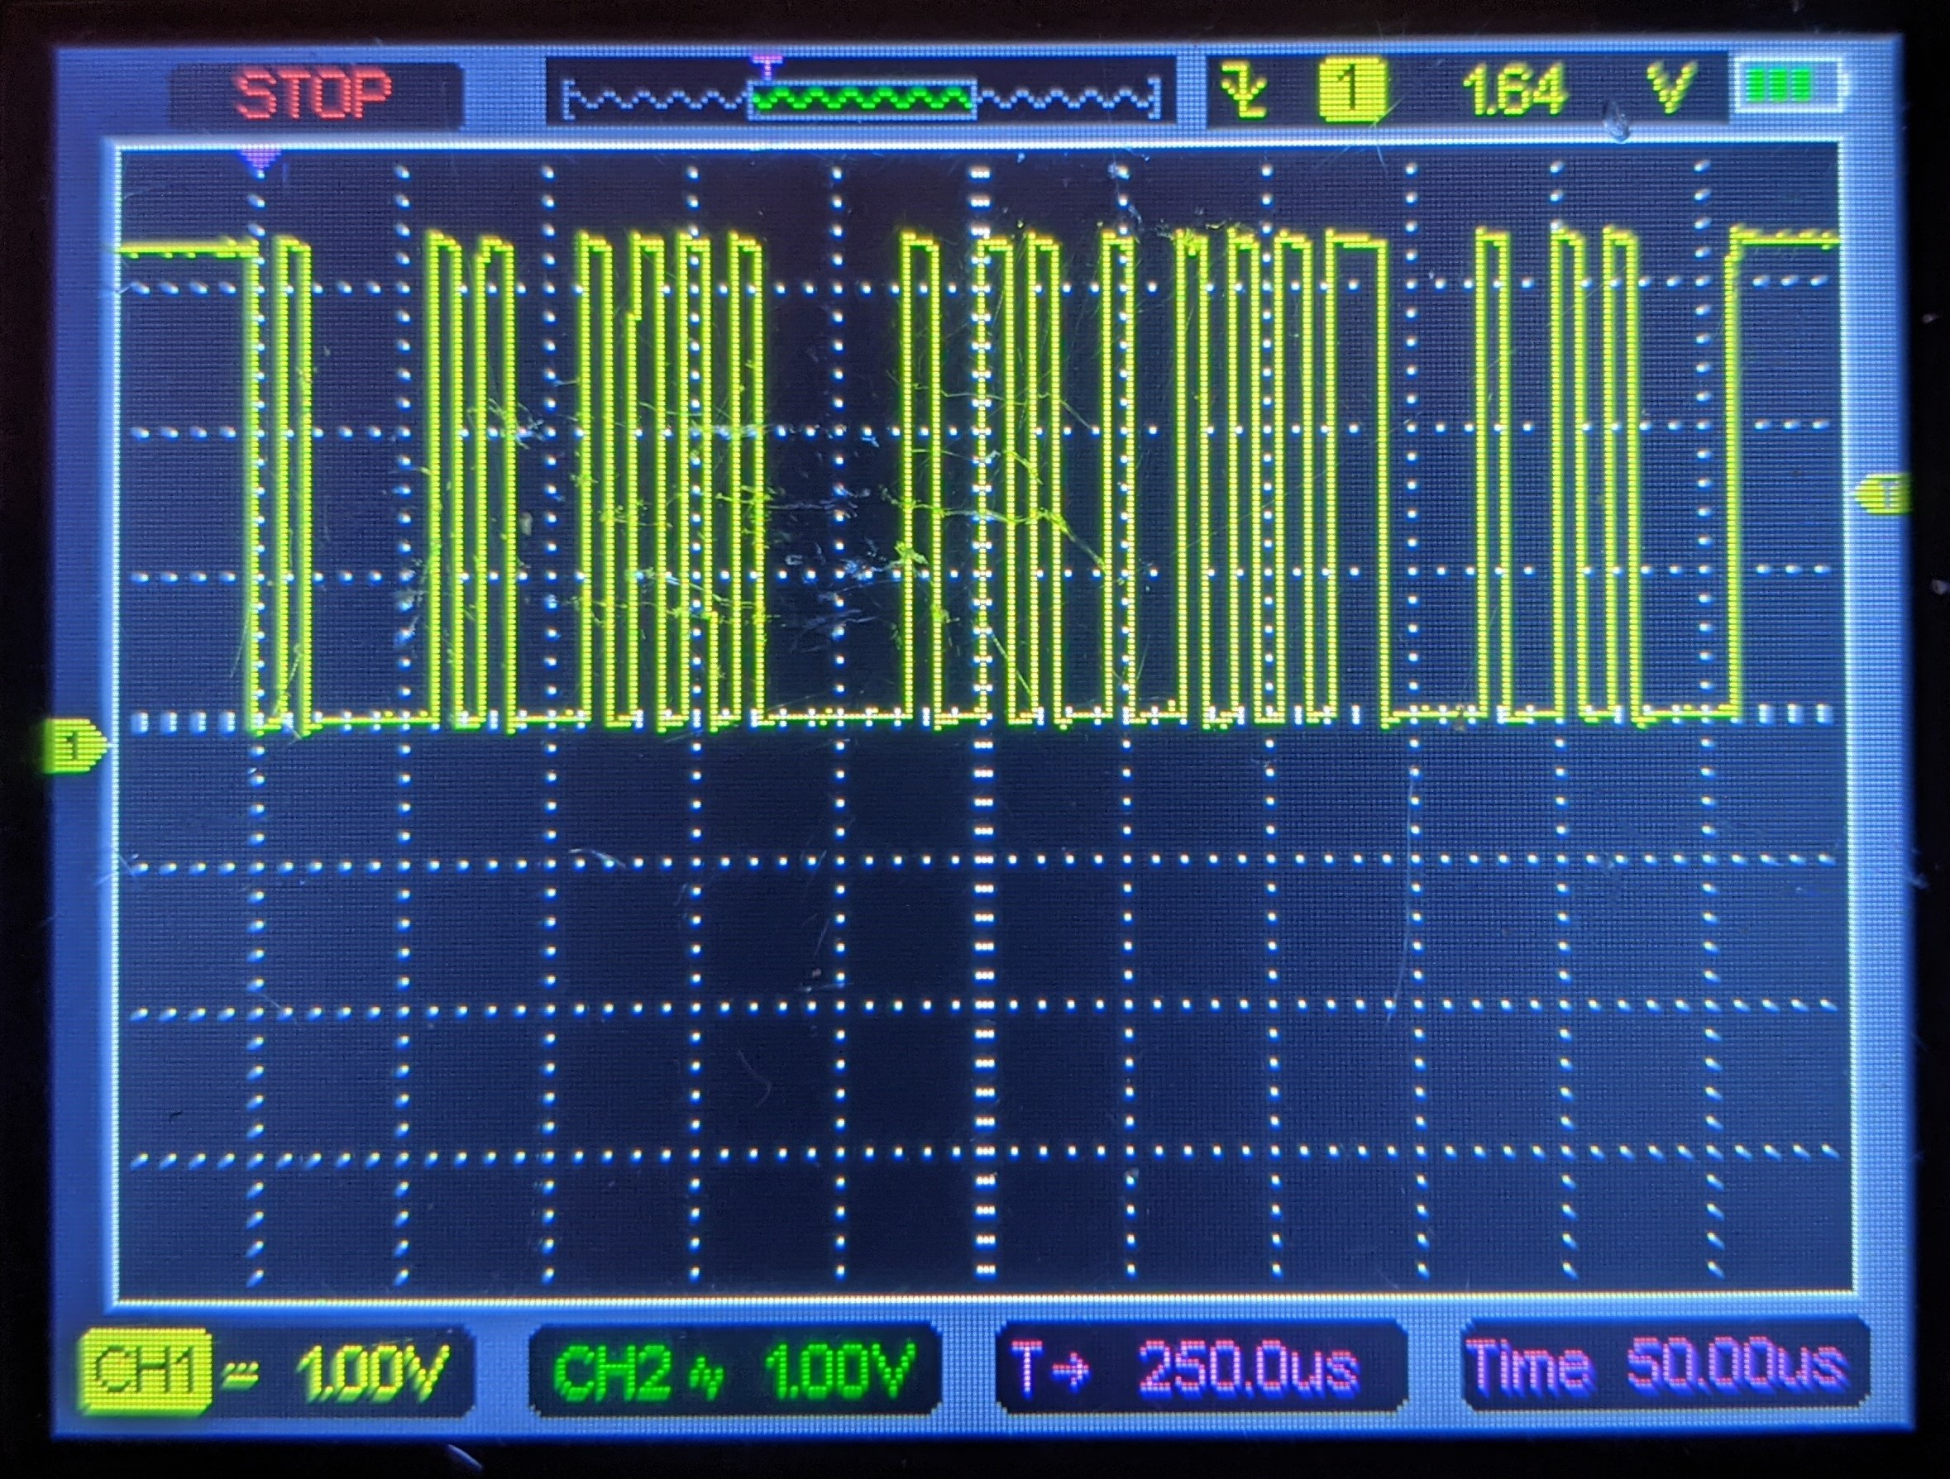
Hardware functionality
During the last design discussion, I mentioned issues with my UART data being incorrect
I was decoding the data MSB first instead of LSB
The UART1 pins on the ESP32 are not recommended for uses other than SPI
Switched to UART0
Arduino Uno (5V)
ESP32 →
(3.3V)

Slide 5
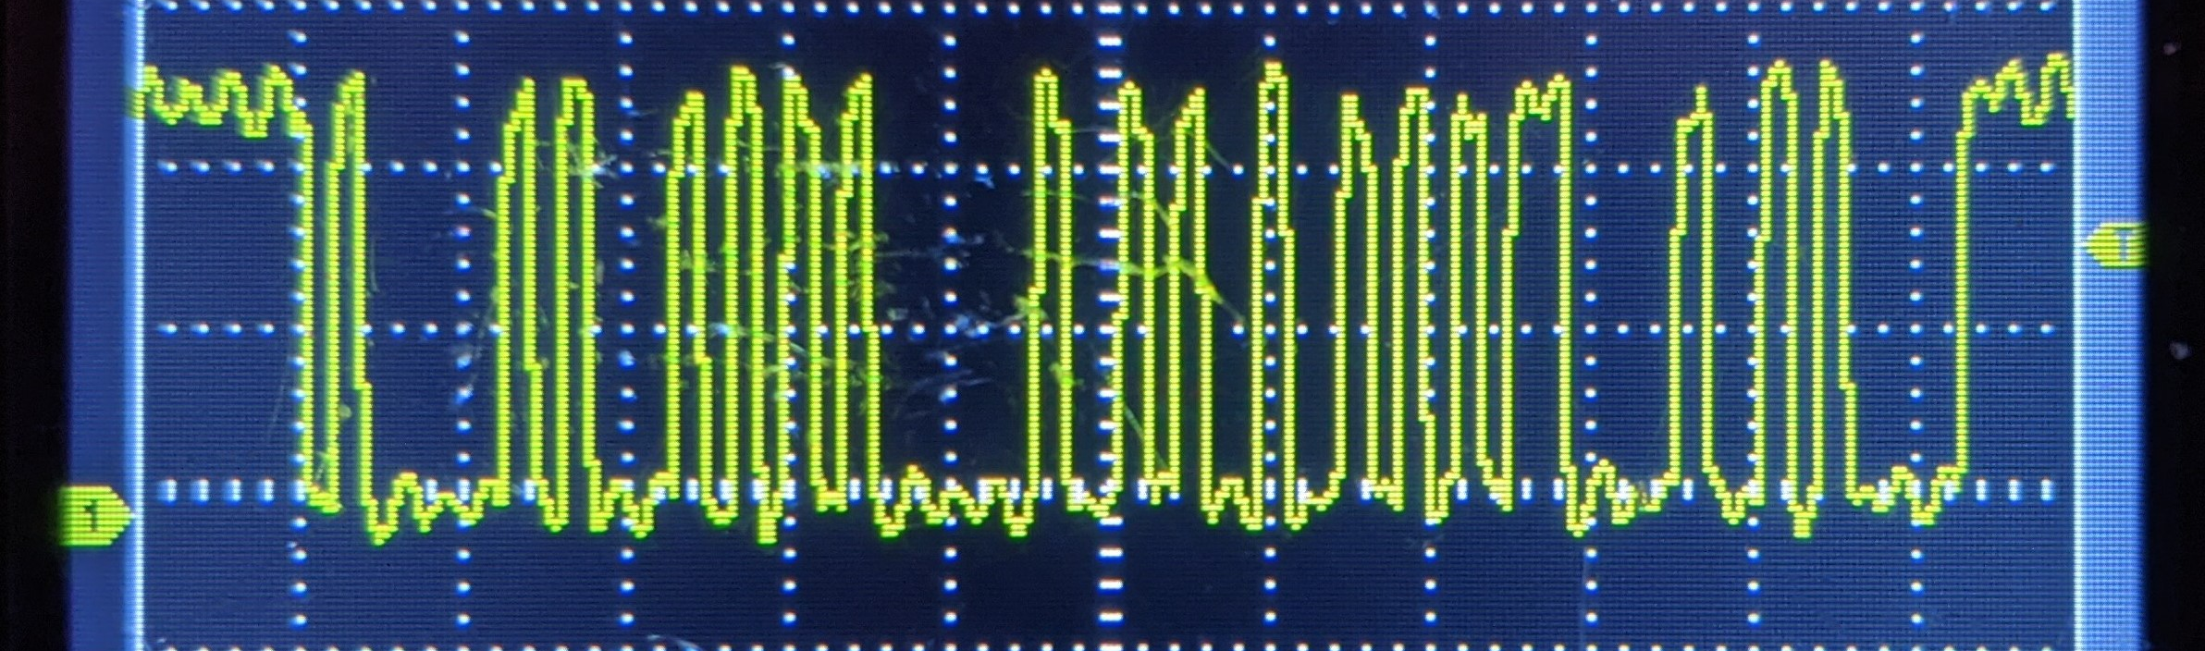
Hardware functionality cont.
This is the “AT I” command sent from the ESP32 after 3.3V to 5V conversion
Noisy, but the data is there
If the ESP32 ground was also connected to the circuit, the line remained high (no data appeared)
Before – 3.3V
After – 5V

Slide 6
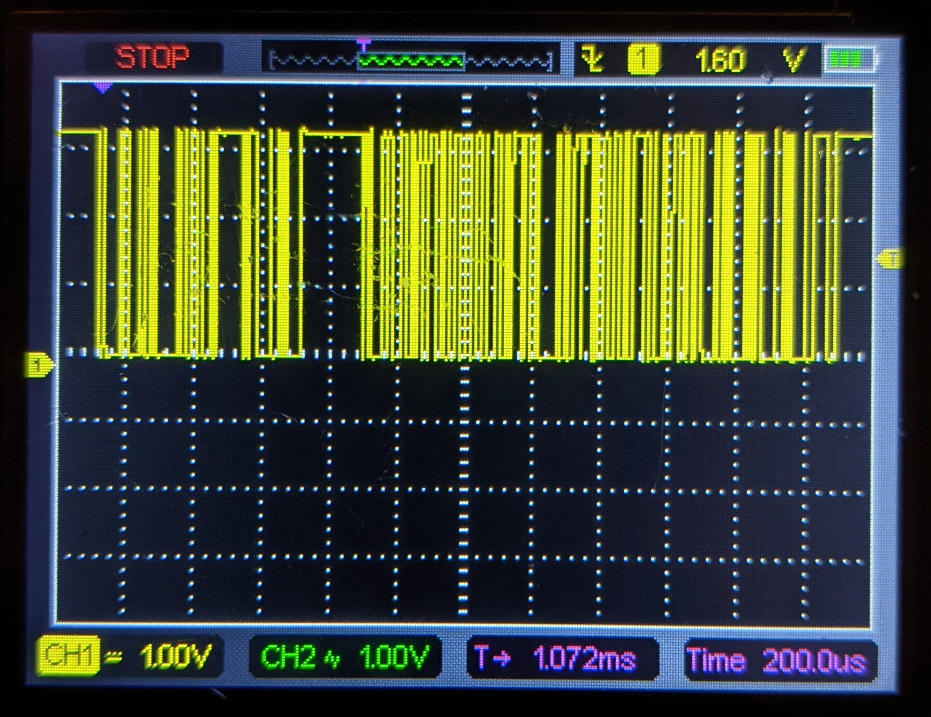
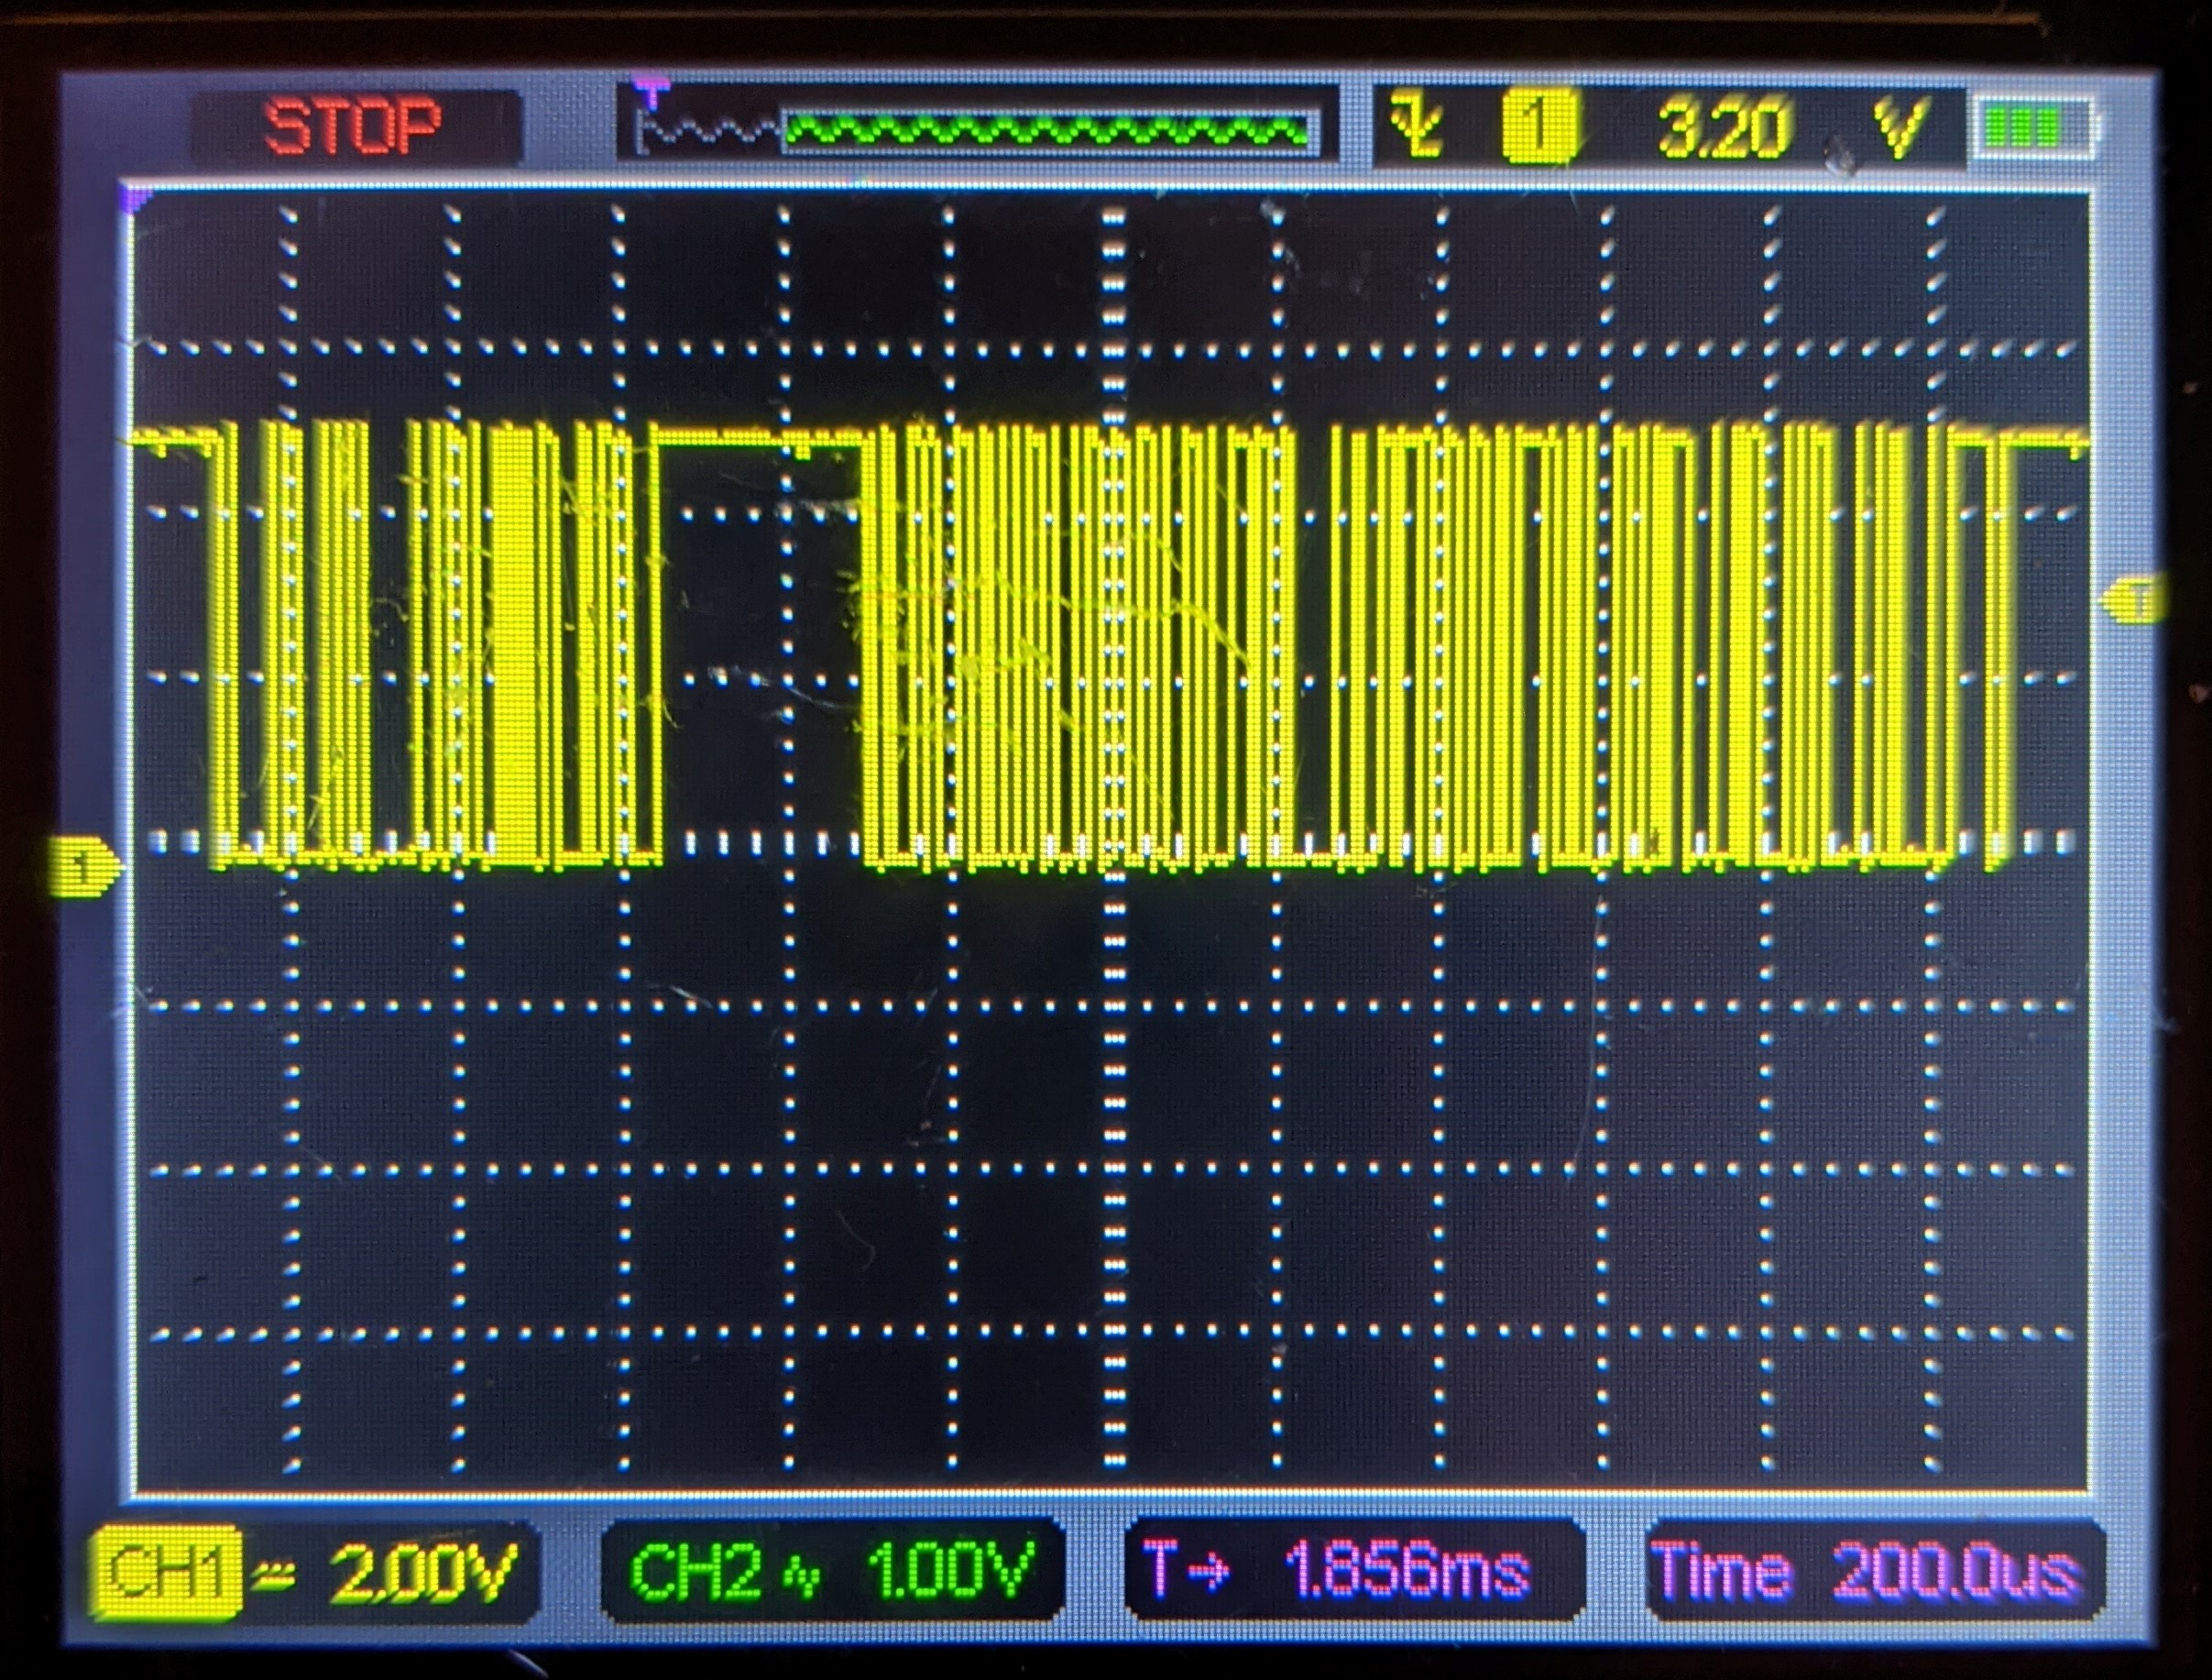
Hardware functionality cont.
This is the ELM327’s response to the “AT I” command sent from the ESP32 after 5V to 3.3V conversion
Noisy, but the data is there
Before – 5V
After – 3.3V
The last piece of hardware to implement is the ADC to the Raspberry Pi 4 to monitor battery voltage

Slide 7
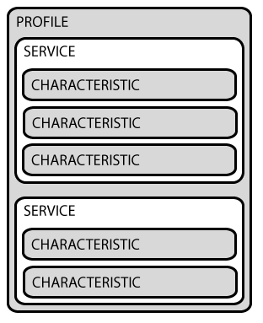
Software functionality
Establishing Bluetooth connection between the Pi and ESP32
Understanding how Bluetooth Low Energy works
Uses GATT (Generic Attribute Profile) to define how devices transfer data using services and characteristics
One device acts as the GATT Server (ESP32) and the other acts as the GATT Client (RPi 4)
The characteristics within services contain data to read, and some can be written to, allowing bi-directional communication
learn.adafruit.com/introduction-to-bluetooth-low-energy/gatt

Slide 8
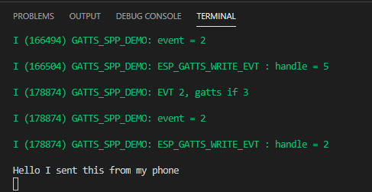
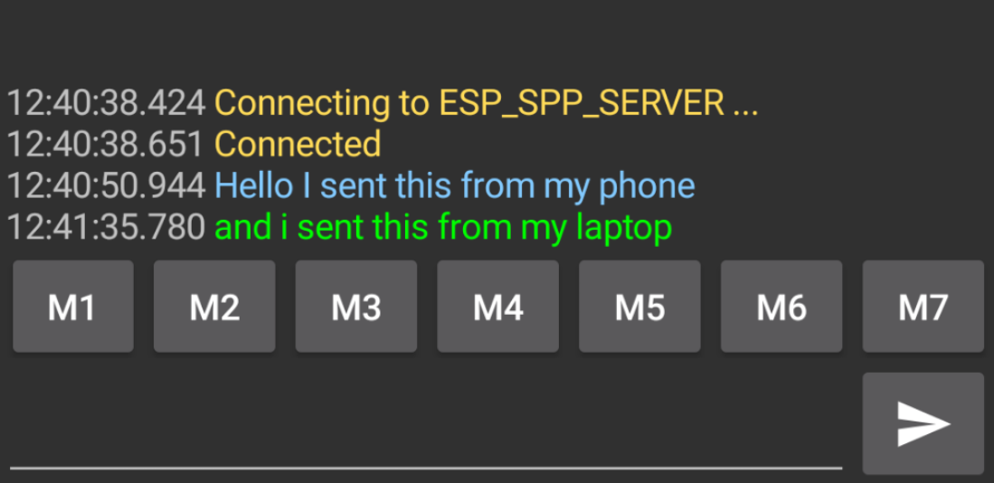
Software functionality cont.
I will need a BLE service that contains two characteristics for TX and RX
This will act as the wireless UART

Slide 9
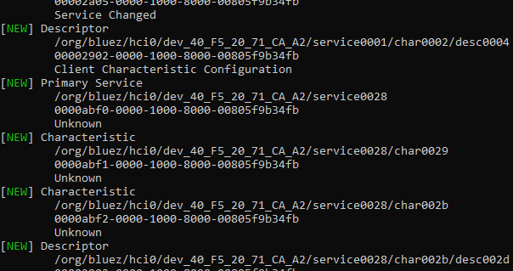
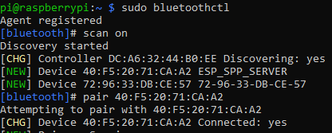
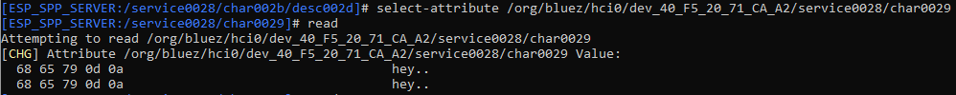
Software functionality cont.

Slide 10
Software functionality cont.
Used an example included in the ESP-IDF extension to establish and test the Bluetooth connection
With help from the examples, I need to setup my own UART service with TX and RX characteristics
Then create a Python script for the Raspberry Pi to pair, connect, then read and write to the Bluetooth characteristics

Slide 11
Changes
Switched from Raspberry Pi OS to Pi OS Lite
Uses less CPU and memory, improving battery life and efficiency
Strips away unnecessary features and services, reducing storage space and boot time
Defaults to the command line, but GUI functionality can be added
Using SSH
May switch to Arduino IDE or Bluetooth Classic if I can’t get BLE going
More documentation, support, and examples
Faster to implement
ESP-IDF utilizes FreeRTOS for its Bluetooth implementation
Need to research and learn about FreeRTOS

Slide 12
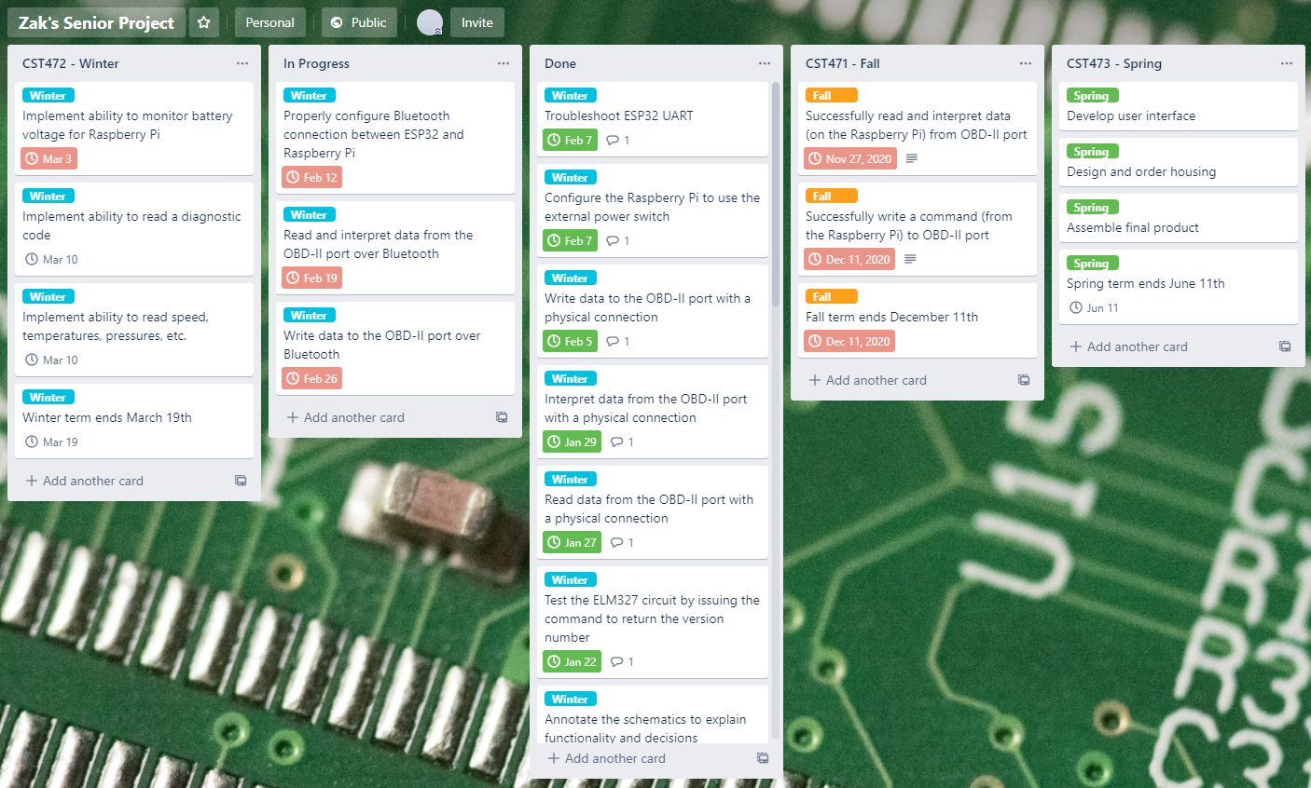
Timeline
https://trello.com/b/57kp2fr0/zaks-senior-project

